Slide 1
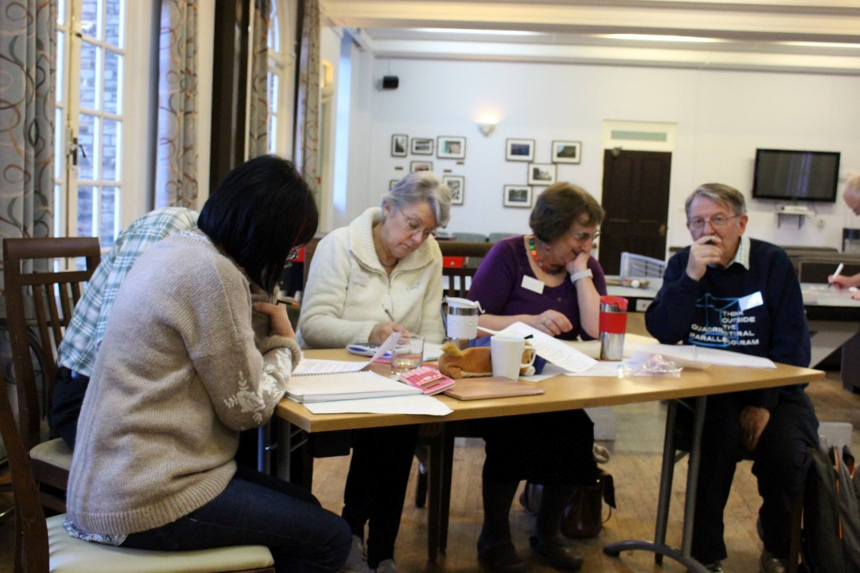
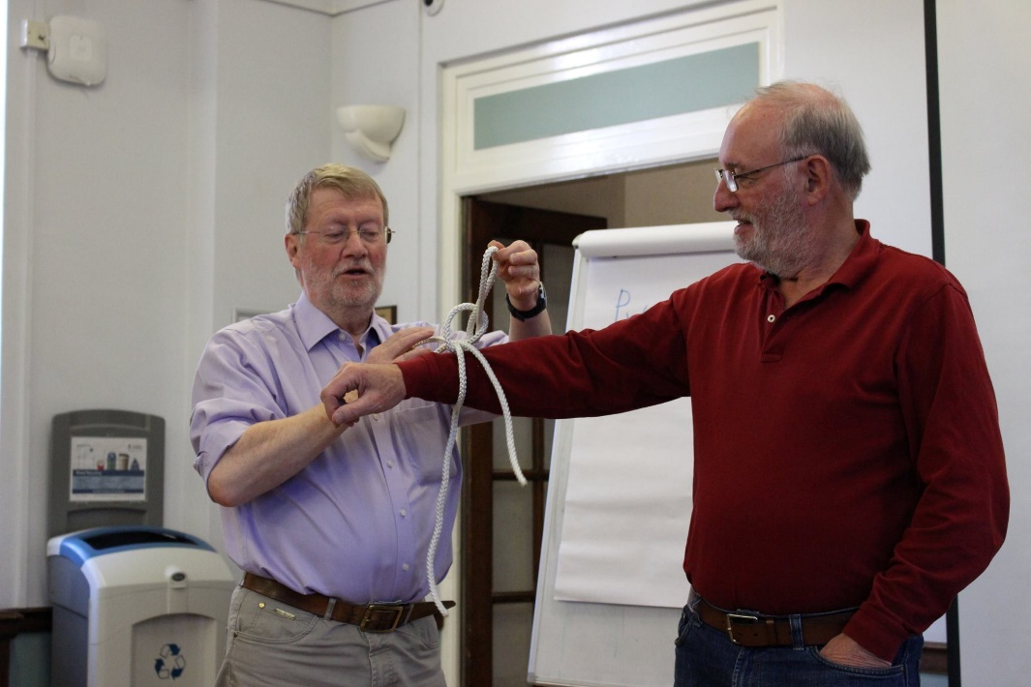
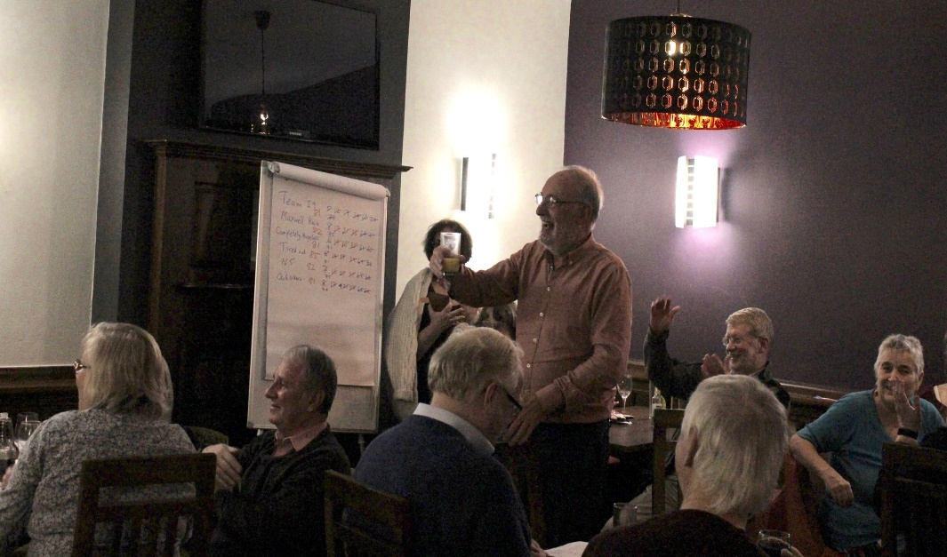
Working in Groups
Knot theory – In practice
Quiz Night
Prize giving

Slide 2
Some recent topics
Mathematical card tricks Code-breaking
Tessellation
Number theory
Venetian multiplication
Covid modelling
Blowing non circular bubbles

